Slide 1
c
© 2021 Teacup Wellness Nonprofit
c
Addiction Recovery Support
our vision
c
Teacup Talks
by Teacup Wellness
®
c

Slide 2
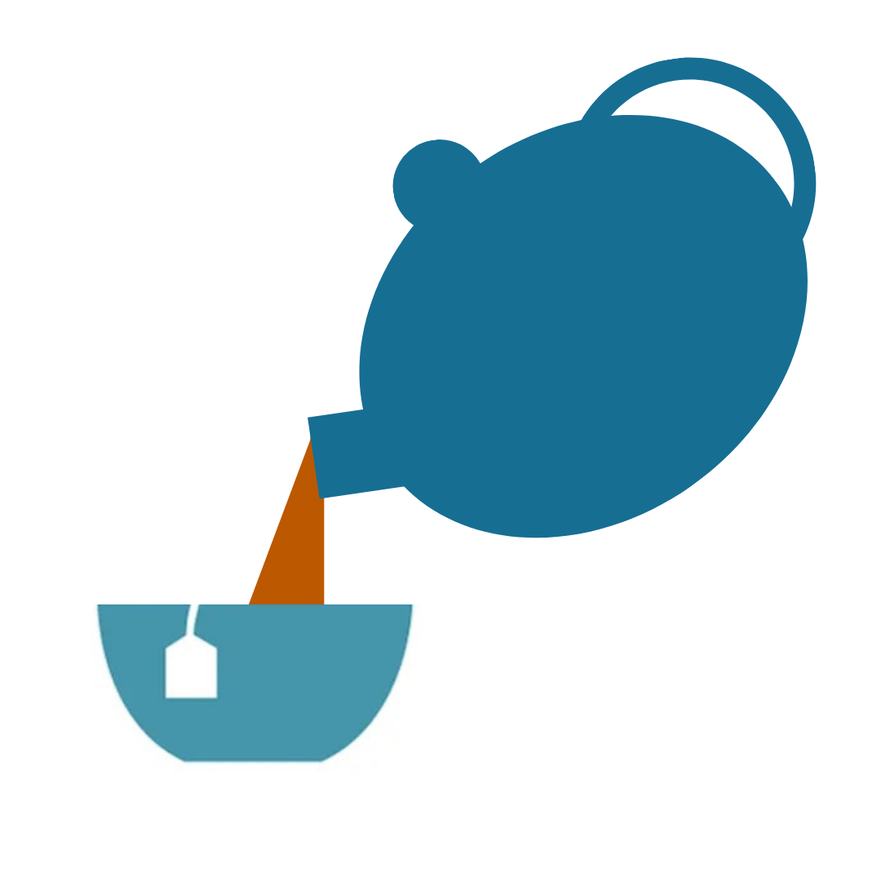
c
© 2021 Teacup Wellness Nonprofit
c
c
Welcome to our Teacup Talk
Meet & greet
20-30-min presentation
Open discussion
c

Slide 3
c
© 2021 Teacup Wellness Nonprofit
c
Addiction Recovery Support
c
Introduction to Teacup Wellness
Our guiding philosophy
c

Slide 4
c
© 2021 Teacup Wellness Nonprofit
c
c
Teacup Wellness is a Colorado non-profit with certified coaches from all over the United States.
Our mission is to use the power of donations to offer wellness coaching to anyone who seeks it.
Our name evokes the warmth of a compassionate chat
Our expertise can guide you in living your best life
c

Slide 5
c
© 2021 Teacup Wellness Nonprofit
c
c
Our qualified coaches’ expertise & unique programs
+
Our compassionate understanding of addiction recovery
=
Our Teacup Wellness approach
c

Slide 6
c
© 2021 Teacup Wellness Nonprofit
c
Overview Philosophy
c
We meet people where they are.
Our primary purpose is to help our clients chart their individual wellness journeys.
c

Slide 7
c
© 2021 Teacup Wellness Nonprofit
c
Overview Philosophy
c
We help bridge the recovery gap.
Client participation in an established recovery program is strongly encouraged, but not required.
c

Slide 8
c
© 2021 Teacup Wellness Nonprofit
c
Overview Philosophy
c
We listen with compassion.
Many people just need to talk with someone who listens and who cares.
We can help.
c

Slide 9
c
© 2021 Teacup Wellness Nonprofit
If we can lighten someone’s burden just a bit, then maybe they can shine a light in someone else’s life.
c

Slide 10
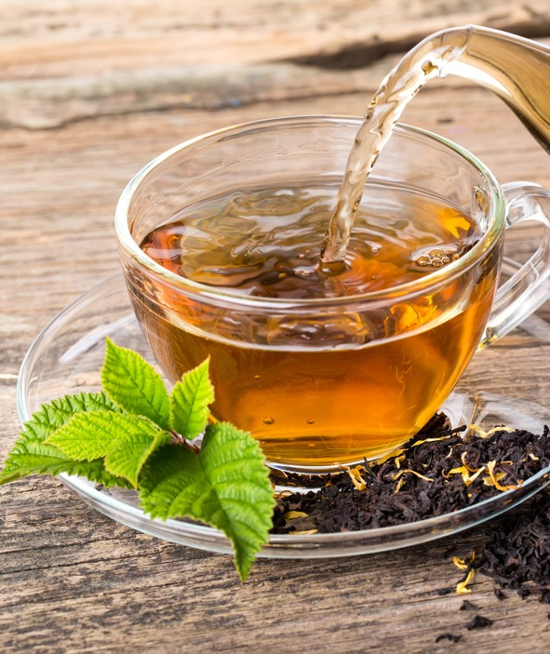
c
© 2021 Teacup Wellness Nonprofit
c
Addiction Recovery Support
c
Setting Client Expectations
c

Slide 11
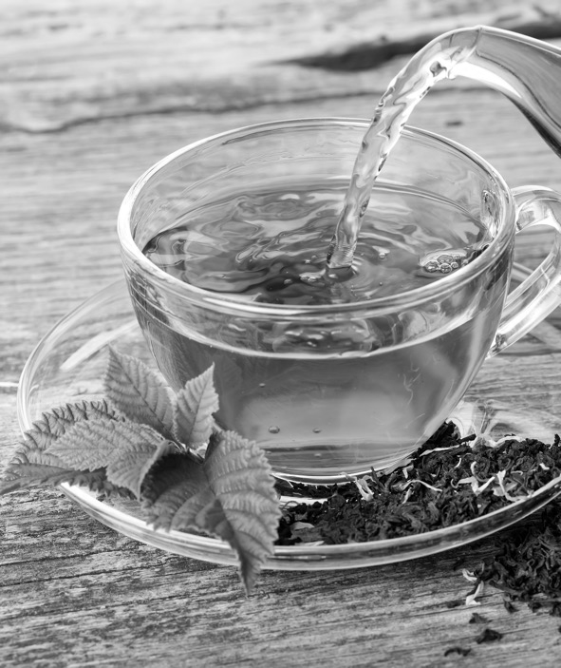
c
© 2021 Teacup Wellness Nonprofit
c
Setting Expectations
c
Patience with the journey is key.
Reminder that making too many dramatic changes in the early days of recovery can increase risk of relapse.
c

Slide 12
c
© 2021 Teacup Wellness Nonprofit
c
Setting Expectations
c
Showing up creates accountability.
If time permits, engage in regular 1-on-1 sessions with agreed-upon dates for the series (6-8 weeks is common).
c

Slide 13
c
© 2021 Teacup Wellness Nonprofit
c
Setting Expectations
c
Showing up for others builds trust.
Join our group sessions and chat rooms on our private client Slack space.
c

Slide 14
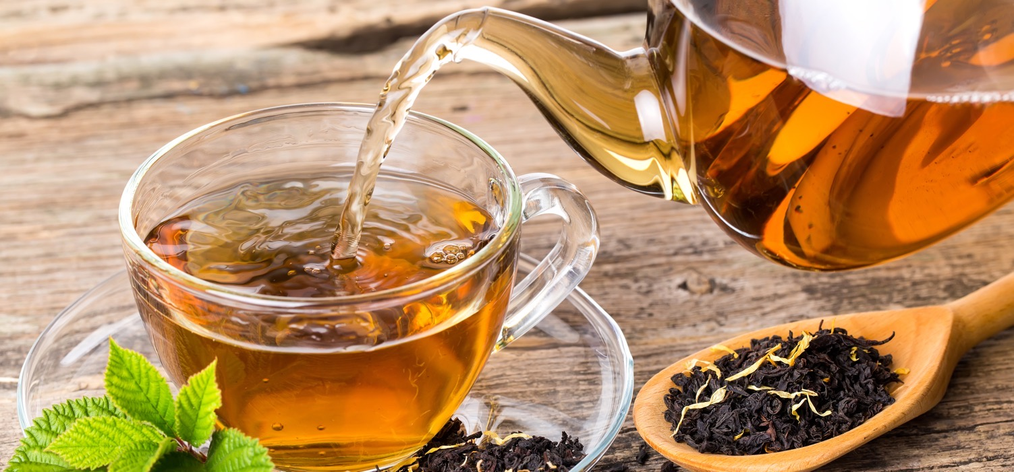
c
© 2021 Teacup Wellness Nonprofit
“There are no conditions on worthiness…
we are worthy of love, belonging and joy now – as is.”
— Brené Brown
c

Slide 15
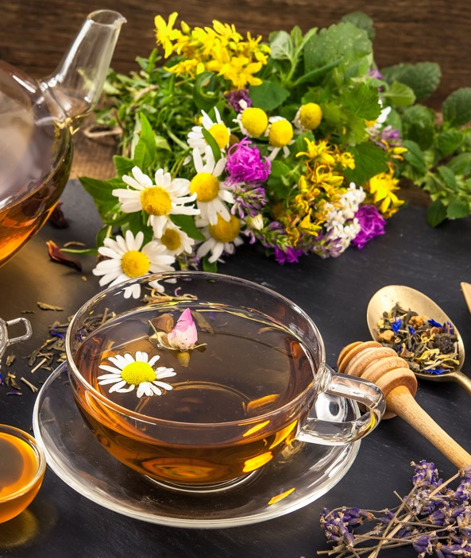
c
© 2021 Teacup Wellness Nonprofit
c
Addiction Recovery Support
c
Living One’s Best Life
c

Slide 16
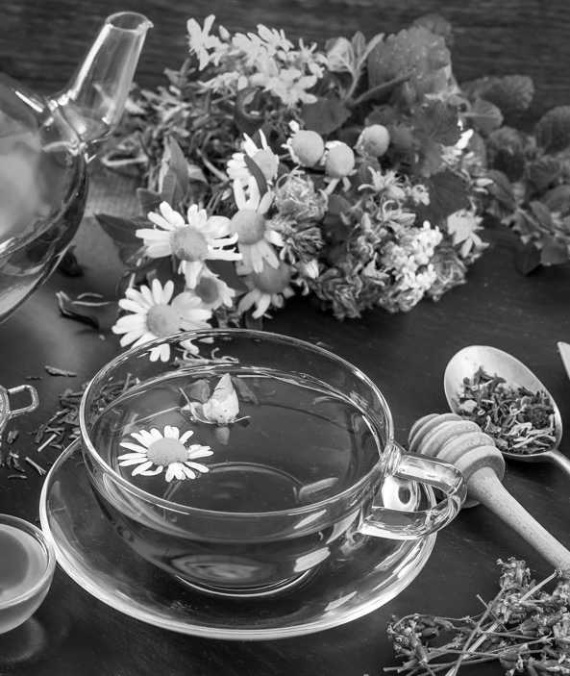
c
© 2021 Teacup Wellness Nonprofit
c
Living One’s Best Life
c
We coach self-care of all kinds.
Addictions often begin in the teen years — learning self-care was never a priority.
We can help.
c

Slide 17
c
© 2021 Teacup Wellness Nonprofit
c
Living One’s Best Life
c
Isolation in addiction is common.
Our recovery communities provide a welcoming and supportive place for everyone to connect with each other.
*
* via Teacup’s private client Slack space
c

Slide 18
c
© 2021 Teacup Wellness Nonprofit
c
Living One’s Best Life
c
Confidence comes from doing.
Be kind to yourself.
“You’ve done enough and you’ve done well.”
c

Slide 19
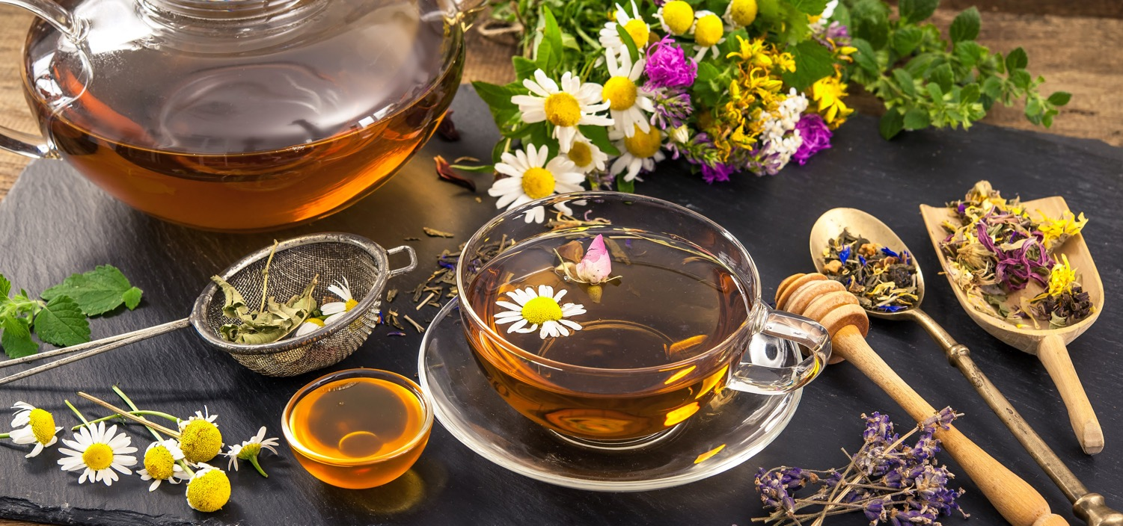
c
© 2021 Teacup Wellness Nonprofit
Social recovery happens when we help each other
heal our shared traumas and embrace our flaws
with loving kindness.
c

Slide 20
c
© 2021 Teacup Wellness Nonprofit
c
Addiction Recovery Support
c
Meditation & Journaling
c

Slide 21
c
© 2021 Teacup Wellness Nonprofit
c
Meditation & Journaling
c
Gratitude is foundational.
Those with more present-moment awareness feel more grounded in their recovery.
It begins with awareness of breath.
c

Slide 22
c
© 2021 Teacup Wellness Nonprofit
c
Meditation & Journaling
c
Purpose motivates & energizes.
Dream for the future without regret for the past.
Helping others can get us out of our own heads and creates a sense of purpose.
c

Slide 23
c
© 2021 Teacup Wellness Nonprofit
c
Meditation & Journaling
c
Magic can happen from just writing.
Begin a journal, even if you’ve never had one before.
Writing can free the mind.
c

Slide 24
c
© 2021 Teacup Wellness Nonprofit
Meditation provides a way of learning how to let go.
c

Slide 25
c
© 2021 Teacup Wellness Nonprofit
c
Addiction Recovery Support
c
Avoid Switching
Addictions
c

Slide 26
c
© 2021 Teacup Wellness Nonprofit
c
Avoid Switching Addictions
c
Recovery leaves gaps.
Addiction develops as a coping mechanism. Understanding what the addiction did for you and then finding other ways to deal with those emotions is essential to long-term recovery.
c

Slide 27
c
© 2021 Teacup Wellness Nonprofit
c
Avoid Switching Addictions
c
Consider surrounding factors.
Comorbidities, illness, family dynamics, co-dependencies, unemployment or work-related issues plus financial situations can all have an effect on the likelihood of success.
c

Slide 28
c
© 2021 Teacup Wellness Nonprofit
c
Avoid Switching Addictions
c
Harm reduction above all else.
Clearing away wreckage and healing from trauma takes time.
It’s understandable to need a few crutches along the way. It’s all about keeping it in perspective.
c

Slide 29
c
© 2021 Teacup Wellness Nonprofit
c
Avoid Switching Addictions
c
Perfection is never the goal.
Experimenting to find what helps is part of the journey.
Compassion for temporary addiction- switching is essential.
The goal is to find long-term healthy options that support long-term recovery.
c

Slide 30
c
© 2021 Teacup Wellness Nonprofit
We all seek a sense of equilibrium.
Understanding that our journeys can vary
leaves room for compassion.
c

Slide 31
c
© 2021 Teacup Wellness Nonprofit
c
Addiction Recovery Support
c
Eating for Recovery
c

Slide 32
c
© 2021 Teacup Wellness Nonprofit
c
Eating for Recovery
Eating for Recovery
c
Strive for progress not perfection.
The temptation to try and
do too many things at once in an effort to clean up one’s life can lead to eating disorders and new addictions.
c

Slide 33
c
© 2021 Teacup Wellness Nonprofit
c
Eating for Recovery
c
Everyone’s dietary needs are unique.
Changing diets early in recovery can be risky.
Encourage lots of fresh water, fruits and vegetables.
c

Slide 34
c
© 2021 Teacup Wellness Nonprofit
c
Eating for Recovery
c
Sugar is often a trigger for cravings.
Berries are low in sugar and high in fiber and nutrients.
Water cleanses the system and can banish cravings.
c

Slide 35
c
© 2021 Teacup Wellness Nonprofit
Nutritious foods support recovery by healing
the microbiome and opening the mind-body connection.
c

Slide 36
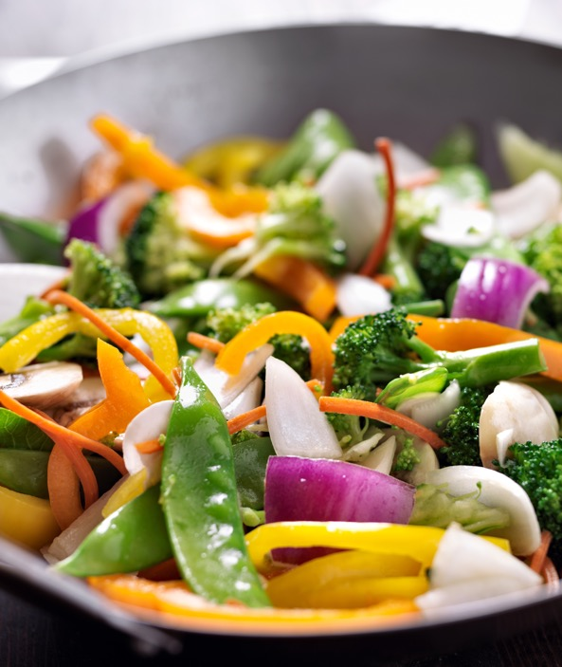
c
© 2021 Teacup Wellness Nonprofit
c
Addiction Recovery Support
c
Cooking Healthy Meals
c

Slide 37
c
© 2021 Teacup Wellness Nonprofit
c
Cooking Healthy Meals
c
Healthy food prepared healthily.
Swap out pantry ingredients that are less healthy for those that are healthier.
Be sensitive to budgets but don’t be afraid to do a pantry purge.
Would you rather put junk food in the trash or have your body be the trash can?
c

Slide 38
c
© 2021 Teacup Wellness Nonprofit
c
Cooking Healthy Meals
c
Healthy food can be simple.
Invest in a good blender.
Toss in a few fruits or greens to make a daily smoothie for the road.
Have precut veggies on hand for quick meal prep and for snacking.
c

Slide 39
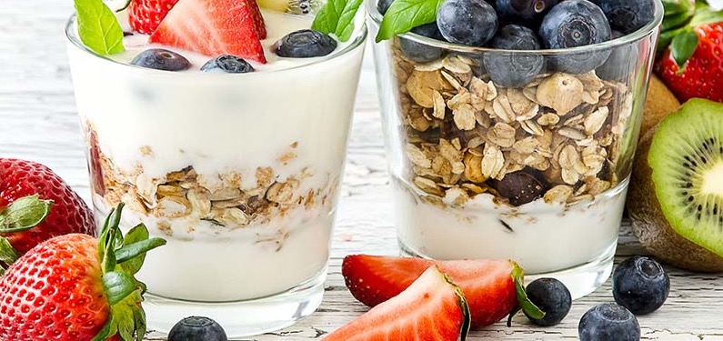
c
© 2021 Teacup Wellness Nonprofit
If we keep more healthy food in the house, we will eat more healthy food.
c

Slide 40
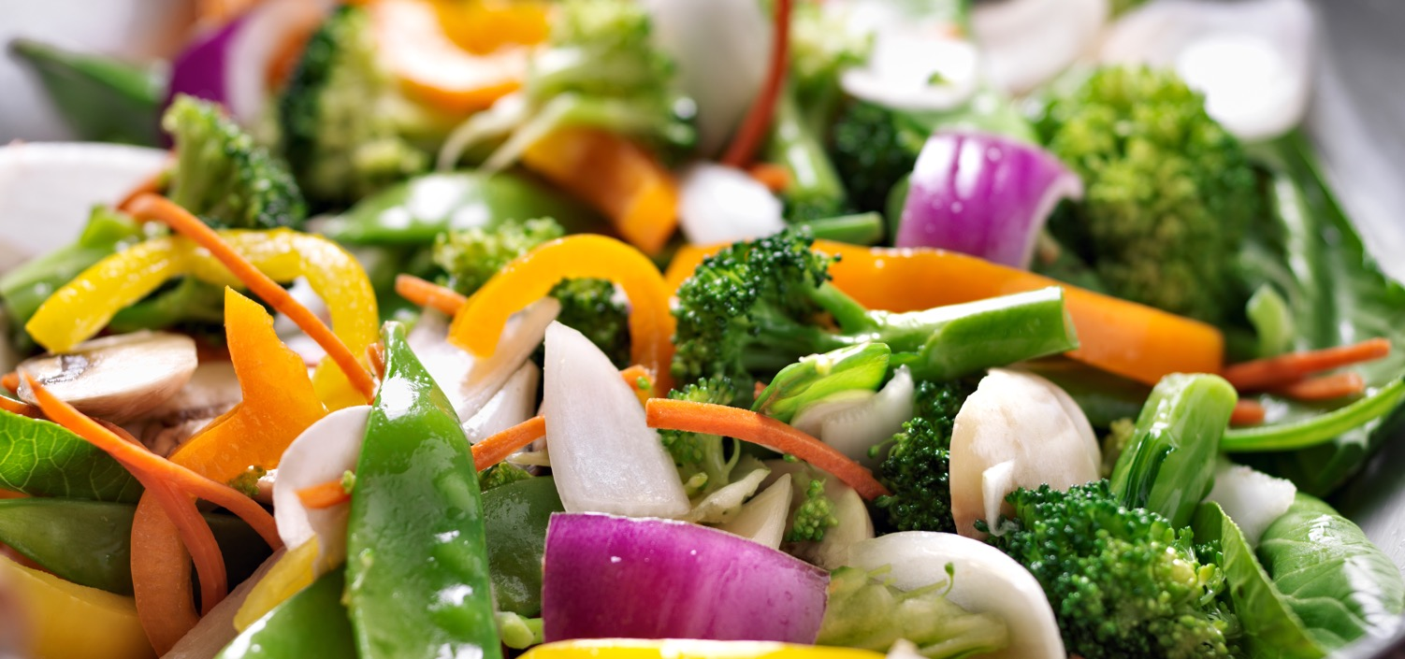
c
© 2021 Teacup Wellness Nonprofit
“No one is born a great cook; one learns by doing”
— Julia Child
c

Slide 41
c
© 2021 Teacup Wellness Nonprofit
c
Addiction Recovery Support
c
Incorporating Exercise
c

Slide 42
c
© 2021 Teacup Wellness Nonprofit
c
Incorporating Exercise
c
Reconnect with the physical self.
Stretching while embracing a quiet mind can help people reconnect with their senses.
c

Slide 43
c
© 2021 Teacup Wellness Nonprofit
The best exercise is the one you’ll keep doing.
c

Slide 44
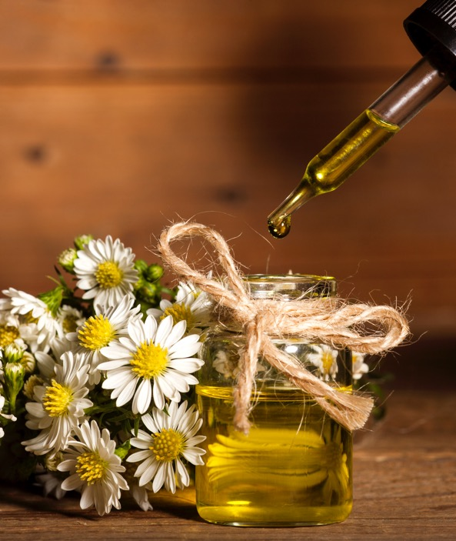
c
© 2021 Teacup Wellness Nonprofit
c
Addiction Recovery Support
c
When Total Abstinence Is Not an Option
c

Slide 45
c
© 2021 Teacup Wellness Nonprofit
c
When Abstinence Is No Option
c
Learning how to moderate.
A hallmark of many addictions is the inability to stop once it’s been triggered. The only safe approach is abstinence.
But what if the addiction is food or social media or the internet? Moderation is the only option but can be difficult to sustain.
c

Slide 46
c
© 2021 Teacup Wellness Nonprofit
c
When Abstinence Is No Option
c
Moderation can be learned.
Pause and assess.
How do you feel?
Are you close to satisfied?
Can you stop?
c

Slide 47
c
© 2021 Teacup Wellness Nonprofit
c
When Abstinence Is No Option
c
Play the tape.
When the pressure is on, it helps to think through the entire sequence of events likely to unfold if use turns to abuse.
How does that tape end?
c

Slide 48
c
© 2021 Teacup Wellness Nonprofit
c
When Abstinence Is No Option
c
Nobody has to go it alone.
Professional help for some types of disorders can be critical for success.
Ask for help.
c

Slide 49
c
© 2021 Teacup Wellness Nonprofit
Making regular wellness investments in oneself helps defend against addictive behavior.
c

Slide 50
c
© 2021 Teacup Wellness Nonprofit
c
Addiction Recovery Support
c
Reduce Likelihood of Relapse
c

Slide 51
c
© 2021 Teacup Wellness Nonprofit
c
Reduce Likelihood of Relapse
c
Realize that relapse happens.
Relapse is an opportunity to gain a deeper understanding of what drives the addiction.
c

Slide 52
c
© 2021 Teacup Wellness Nonprofit
c
Reduce Likelihood of Relapse
c
It’s only an obsessive thought.
When craving hits, remember that we don’t need to act on it.
The craving will go away.
c

Slide 53
c
© 2021 Teacup Wellness Nonprofit
c
Reduce Likelihood of Relapse
c
(thanks to Gabor Maté)
It’s not how we feel that counts.
It’s what we do.
c

Slide 54
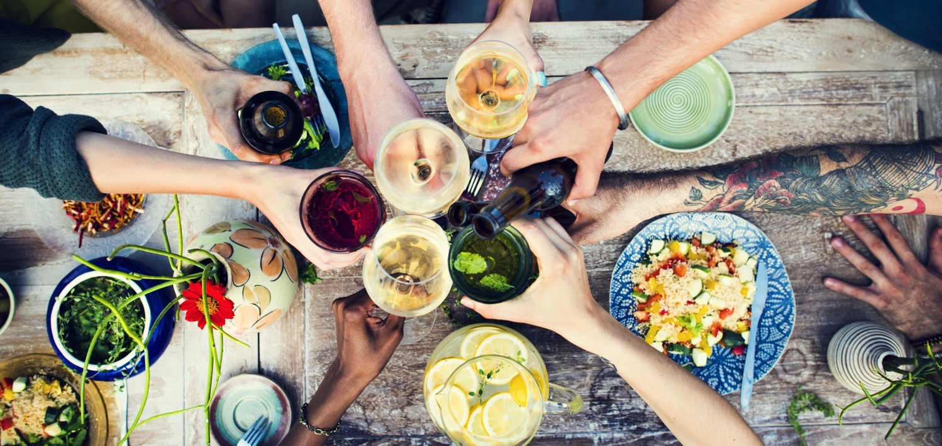
c
© 2021 Teacup Wellness Nonprofit
Addiction and recovery is a social affair.
It involves family members, coworkers, friends, and the community at large.
c

Slide 55
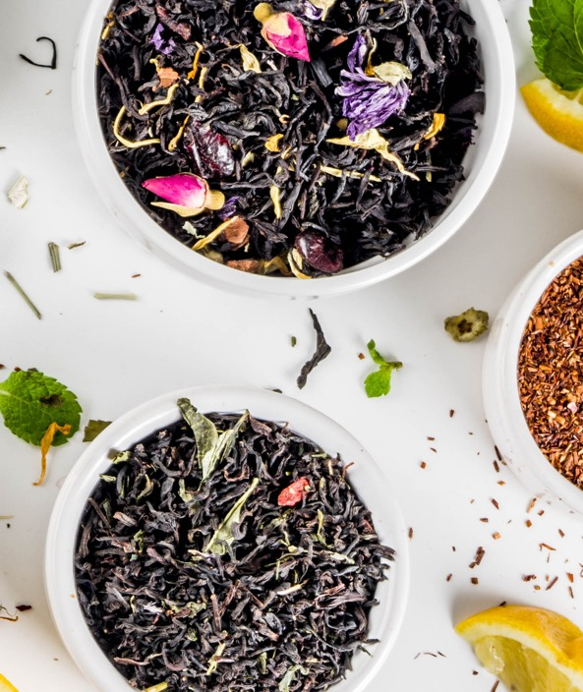
c
© 2021 Teacup Wellness Nonprofit
c
Addiction Recovery Support
c
Unleash Creativity & Purpose
c

Slide 56
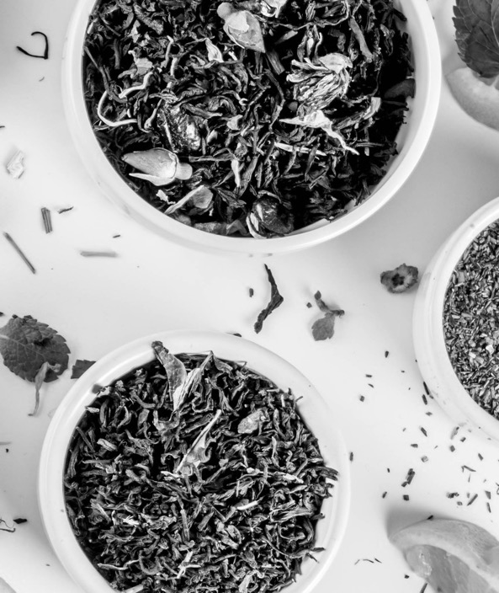
c
© 2021 Teacup Wellness Nonprofit
c
Unleash Creativity & Purpose
c
Creativity cries out for expression.
Many addicts abandon their art while in the throes of addiction.
Learning to live addiction-free means reconnecting with core creativity and expressing it again.
c

Slide 57
c
© 2021 Teacup Wellness Nonprofit
c
Unleash Creativity & Purpose
c
Nature is the universal healer.
Many find a sense of purpose when reconnecting with nature.
Regular immersion in natural surroundings is proven to help sustain and deepen recovery.
c

Slide 58
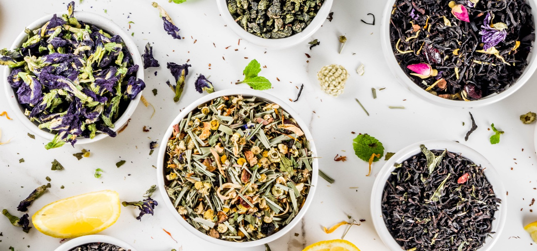
c
© 2021 Teacup Wellness Nonprofit
“…ask yourself what makes you come alive
and then go and do that… what the world needs is people who have come alive”
— Howard Thurman
c

Slide 59
c
© 2021 Teacup Wellness Nonprofit
c
Thank you
our vision
c
We thrive on the generosity of our donors and sponsors
teacupwellness.org/Donate
c

Slide 60
c
© 2021 Teacup Wellness Nonprofit
c
Need more info?
our vision
c
Please drop us a line.
hello@teacupwellness.org
c

Slide 61
c
Perfect time for a walk or a cup of tea…
c

